Slide 1




GRAPHIC DESIGNING
AN ESSENTIAL TOOL TO DECORATE TECH-WORLD
RURALNET TRAINING COLLEGE

Slide 2

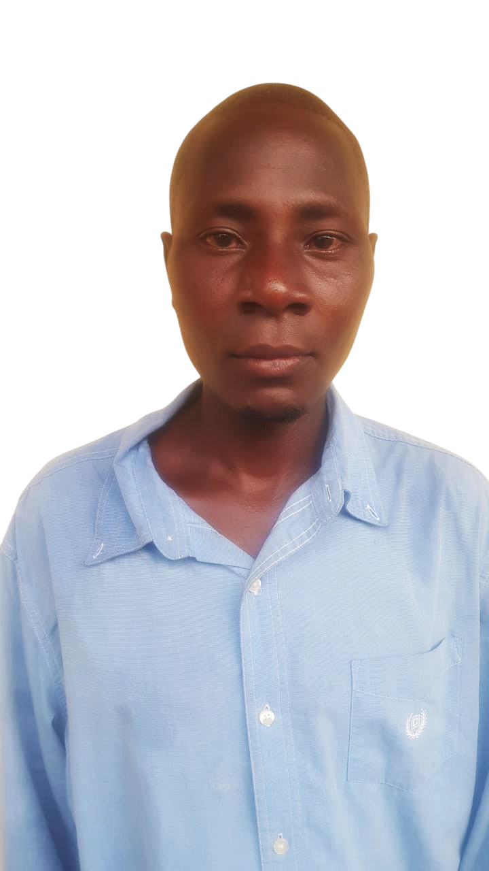


ROAD CLERK
RANGALA BOOKING OFFICE
CHAIRMAN
MAURICE OCHIENG
MAURICE OCHIENG

Slide 3
COURSE DETAILS
CODE | COURSE | DURATION | QUALIFICATION | FEES
ICT101 | ICT Essentials | 2 months | Open | 6,600
WEB103 | Web Development | 3 months |  | 20,000
PYT106 | Programming | 6 months |  | 35,000
GRD101 | Graphic Designing | 1 month |  | 10,000
CCTV101 | CCTV Operations | 1 month |  | 15,000
CRM102 | Compute Repair and Maintanance | 2 months |  | 10,000
QBO101 | Quickbooks | 1 month |  | 14,000
DA103 | Data Analysis | 3 months |  | 20,000
DM101 | Digital Marketing | 2 months |  | 20,000
Course codes for:
ICT essentials (2 months),
Web development (3 months),
Python Programming (6 months),
Graphic Designing (1 month),
CCTV Operations (2 months)
Computer Repair & Maintanance (2 months)
QuickBooks (1 month)

Slide 4

CODE
COURSE
DURATION
QUALIFICATION
FEES
ICT101
ICT Essentials
2 months
Open
6,600
WEB103
Web Development
3 months
20,000
PYT106
Programming
6 months
35,000
GRD101
Graphic Designing
1 month
10,000
CCTV101
CCTV Operations
1 month
15,000
CRM102
Compute Repair and Maintanance
2 months
10,000
QBO101
Quickbooks
1 month
14,000
DA103
Data Analysis
3 months
20,000
DM101
Digital Marketing
2 months
20,000
CM11-23
Certificate in Accounting and Management Skills
12 months
KCSE D
25,500
AD11-34
Accounting Technician Diploma
18 months
KCSE C-
38,500
DQM11-47
Diploma in Quality Management
24 months
KCSE C-
54,600
DN11-33
Diploma in Computer Network and System Administration
24 months
KCSE C-
40,000
DD11-33
Diploma in Data Management and Analytics
24 months
KCSE C-
40,100
CA11-37WP
Certified Public Accountants
48 months
KCSE C+
115,800
Accounting & Finance

